Slide 1

SPARQ Platform
Automating Business Assurance with AI Agents
Onboarding Module + SPARQ Studio for Enterprise-Scale Automation

Slide 2
Manual Business Assurance = Operational Bottleneck
Today's business assurance operations face a critical challenge. More than 100 specialists spend their days manually answering complex questions, navigating fragmented systems, applying intricate business rules, and generating compliance evidence. This manual approach has become the organization's primary operational constraint.
Operational Inefficiencies
Human Error & Variability
Slow Onboarding
High cycle time per case with duplicate effort across teams creates limited scalability. Manual processes cannot keep pace with growing business demands.
Output quality depends entirely on analyst experience. Inconsistent decisions lack transparency and auditability, creating compliance exposure.
Each new use-case requires custom SOPs and rules with no standardized automation approach or reuse across business units.
The Result: Operations become the bottleneck. Compliance risk increases. Decisions lack consistency. Your enterprise is constrained by manual processes that cannot scale.

Slide 3
SPARQ Platform: Unified AI-Agent Automation
SPARQ delivers a unified, multitenant, on-premises platform that fundamentally transforms business-assurance workflows. Built for enterprise financial services, SPARQ automates complex decision-making while maintaining the governance and auditability that regulated institutions require.
01
02
Onboarding Module
SPARQ Studio
Tenant-aware portal converts business requirements into machine-readable specifications with complete metadata captured in JSON/YAML runbook format.
Transforms runbook specs into deployable AI agents with natural-language runbooks, YAML configs, and Agent.py code. Test on synthetic data with explainable reasoning.
03
04
CI/CD + Deployment
Multitenant Architecture
GitHub integration enables version control and collaboration with human-in-loop review before deployment to on-premises OCP infrastructure.
Each business unit operates as an isolated tenant with shared infrastructure, complete data isolation, and enterprise-wide governance.

Slide 4
Transformational Value Proposition
70-90%
100%
100+
Cycle Time Reduction
Decision Traceability
Analysts Redeployed
Replace multi-system manual checks with automated agents that deliver decisions in minutes, not hours or days.
Every decision comes with complete traceable reasoning, reducing compliance risk and audit burden significantly.
Free your specialist workforce from manual checks to focus on exceptions and high-value strategic work.
Rapid Use-Case Onboarding
True Enterprise Scalability
On-Premises Security
Turn a business idea into a running agent in hours, not weeks. Pre-built templates, action library, and synthetic data validation accelerate time-to-value.
Support multiple business units and use-cases per tenant. Eliminate duplicated effort across the organization with one unified platform.
Runs in OCP with enterprise-grade controls. Your data never leaves your environment, ensuring compliance with the strictest regulatory requirements.

Slide 5

Consistency, Accuracy & Explainability
SPARQ fundamentally changes how your organization makes business-assurance decisions. Every automated decision includes complete, traceable reasoning that satisfies auditors and regulators. SMEs retain full control through human-in-loop governance—they approve, review, tune, and govern while the platform handles execution. Final decision authority always remains internal, ensuring your organization maintains accountability while gaining unprecedented efficiency and consistency.

Slide 6


End-to-End Platform Architecture
SPARQ Studio
Onboarding Module
Natural-language runbook editor
Tenant registration and configuration
Pre-built and custom actions
Use-case definition with guided wizard
LLM configuration and tuning
Data-source configuration
Data-source connectors
Synthetic scenario creation
Agent.py, YAML config, and prompt generation
Runbook specification output (JSON/YAML)
Multitenant Management
CI/CD + Deployment
Tenant isolation and security controls
GitHub integration for version control
Resource quotas and metering
Human review and refinement workflow
Role-based access control
Staging environment testing
Monitoring and compliance reporting
Production deployment to OCP
This architecture ensures enterprise-grade security, scalability, and governance while delivering the agility required for rapid use-case deployment across multiple business units.

Slide 7
Comprehensive Feature Catalog
SPARQ delivers 40+ enterprise-grade features across two core modules, providing everything needed for end-to-end business-assurance automation.
Onboarding Module
SPARQ Studio
Tenant registration and settings management
Natural-language runbook editor
Use-case onboarding wizard with templates
Pre-built action gallery
Data-source configuration interface
Custom action SDK for extensions
Synthetic scenario definition panel
Multi-provider LLM configuration
Tenant-scoped use-case dashboard
Data-source connector cockpit
Complete version history tracking
Tenant/namespace isolation
Role-based access control (RBAC)
YAML and Agent code export
Workflow engine (Draft → Approved → Active)
GitHub/CI integration
Reviewer UI with approvals and comments
Transparent reasoning and trace logging
JSON/YAML specification export
Test harness with synthetic data
Interactive runbook preview
Agent versioning and lifecycle management
Notifications and alerts system
Deployment-ready artifact generation
Inline help and validation
Real-time monitoring and metrics
Use-case cloning capability
Human-in-loop feedback interface
Complete audit log capture
Continuous improvement and learning
Additional capabilities include tenant configuration defaults, user management, pre-built action gallery, billing and metering, resource quotas, custom branding per tenant, and enterprise-wide governance controls.

Slide 8





Enterprise Multitenant Architecture
SPARQ's multitenant architecture enables enterprise scalability while ensuring complete data isolation and security. Each business unit operates as an isolated tenant with custom configurations, templates, data sources, and agents—all while sharing infrastructure for cost efficiency.
Isolation & Security
Resource Management
Tenant data, agents, and configurations are completely isolated with zero cross-contamination. Enterprise-grade security controls protect each tenant independently.
Per-tenant quotas control agent runs, synthetic data usage, and compute resources. Prevent runaway costs while ensuring fair resource allocation.
Billing & Metering
Custom Branding
Track detailed usage per tenant for accurate chargeback or billing. Complete visibility into platform consumption across the enterprise.
Each tenant can customize logos, colors, and UI themes to match their business unit identity while maintaining platform consistency.
Enterprise Benefits: Eliminate siloed processes, enable knowledge reuse across business units, streamline governance and compliance, and scale seamlessly with organizational growth.

Slide 9
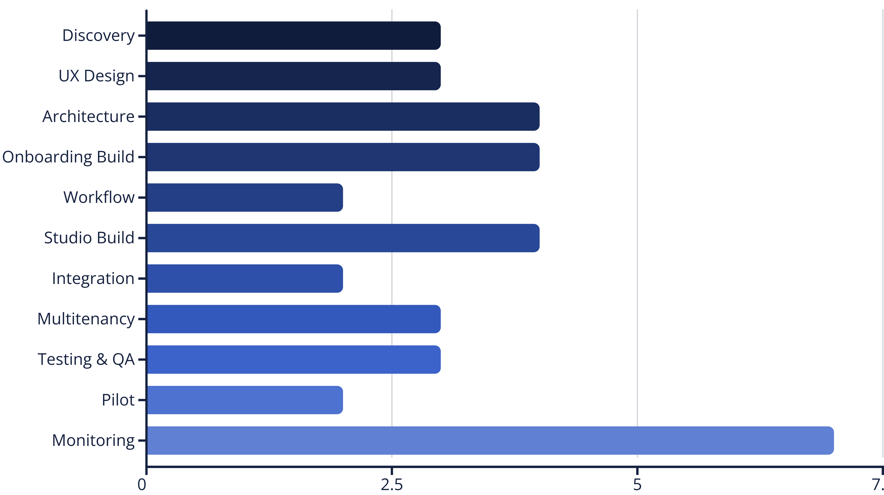
11-Phase Implementation Roadmap
Our comprehensive project plan delivers the complete SPARQ platform in 37 weeks (8-9 months) through carefully structured phases.
This timeline includes comprehensive stakeholder workshops, UX prototyping, backend architecture, core module development, integration work, rigorous testing, pilot deployment with selected tenants, and ongoing post-launch monitoring and enhancement.

Slide 10
Implementation Phases: Foundation
Phase 1: Discovery & Requirements (3 weeks)
1
Conduct comprehensive stakeholder workshops across business units to gather requirements, map existing use-cases, and define the multitenant model. Deliverable: Prioritized feature list with detailed specifications.
2
Phase 2: UX Design & Prototyping (3 weeks)
Create detailed wireframes and clickable prototypes for all modules. Validate designs with end users and stakeholders to ensure intuitive workflows and adoption readiness.
Phase 3: Backend & Architecture (4 weeks)
3
Define comprehensive data model, establish API surface specifications, and architect the multitenant isolation strategy. Includes security architecture, infrastructure planning, and integration patterns.
These foundational phases establish the technical and operational framework that ensures successful delivery of subsequent development phases. All critical architectural decisions are finalized before major development investment begins.

Slide 11

Implementation Phases: Core Development
Phase 4: Onboarding Module (4 weeks)
Phase 5: Workflow & Governance (2 weeks)
Phase 6: Studio Module (4 weeks)
Build tenant registration, use-case forms with guided wizards, template library, and tenant-scoped dashboards. Implement data-source configuration and synthetic scenario definition capabilities.
Integrate Sema4.ai Studio, build the action gallery, implement runbook editor, and develop export functionality for agent deployment artifacts.
Develop RBAC system, reviewer UI with approval workflows, notification engine, and comprehensive audit logging. Ensure all governance requirements are embedded from the start.
Phase 7: Integration (2 weeks)
Connect Onboarding → Studio → CI/CD pipeline with GitHub integration, artifact generation, and automated test harness.
Phase 8: Multitenancy (3 weeks)
Implement resource management, billing and metering systems, custom branding capabilities, and comprehensive metrics dashboards.
These core development phases deliver the primary platform functionality. By Phase 8 completion, all major features are implemented and ready for comprehensive testing.

Slide 12





Implementation Phases: Testing & Launch
Phase 9: Testing & QA
Comprehensive end-to-end UAT with business users, security penetration testing, performance validation, and complete documentation creation. All critical paths validated before pilot.
Phase 10: Pilot Deployment
Onboard 1-2 pilot tenants with carefully selected use-cases. Collect detailed feedback, refine based on real-world usage, and validate production readiness.
Phase 11: Production & Beyond
Full production deployment to OCP infrastructure, comprehensive user training programs, and ongoing monitoring with continuous enhancement releases.
Total Timeline: 37 weeks from project kickoff to full production deployment with ongoing monitoring and enhancement. Pilot begins at Week 32, with production launch at Week 37.

Slide 13

Resource Requirements & Team Structure
Recommended Team Composition
Successful delivery requires a cross-functional team of 10-12 full-time professionals with specialized expertise:
Product Manager (1 FTE)
Owns product vision, stakeholder alignment, and delivery coordination across all phases.
UX/UI Designers (1-2 FTE)
Create intuitive interfaces and ensure consistent user experience across both modules.
Backend Engineers (2-3 FTE)
Build core platform services, multitenant architecture, and integration layer.
Frontend Engineers (2 FTE)
Develop responsive web interfaces for both Onboarding and Studio modules.
DevOps/Infrastructure (1 FTE)
Manage OCP deployment, CI/CD pipelines, monitoring, and infrastructure automation.
QA Engineers (1-2 FTE)
Key Investment Areas
Comprehensive testing across security, performance, functionality, and user acceptance.
Sema4.ai Studio licensing and integration
LLM provider costs (OpenAI, Azure, or on-premises)
OCP infrastructure and licensing
Team salaries and specialized training
Security, compliance, and testing infrastructure

Slide 14

Success Metrics & KPIs
SPARQ's success will be measured across four critical dimensions: adoption, performance, business impact, and operational excellence. These metrics provide comprehensive visibility into platform value delivery.
Adoption Metrics
Performance Metrics
Number of tenants onboarded
Agent run success rate
Number of use-cases created
Average decision latency
Agents deployed to production
Synthetic data test coverage
Active users per tenant
System uptime and reliability
Business Metrics
Operational Metrics
Cycle time reduction (target: 70-90%)
Tenant resource utilization
Manual effort reduction percentage
Platform cost per tenant
Cost savings per automated decision
Support ticket volume and resolution
Compliance audit pass rate
Feature adoption rates
Quarterly business reviews will track these KPIs against targets, enabling data-driven optimization of platform capabilities and resource allocation.

Slide 15
Risk Mitigation Strategy
Risk
Impact
Mitigation Strategy
Scope Creep
Timeline delays and budget overruns
Strict feature prioritization with MVP focus. Implement phased releases with clear acceptance criteria. Change control board reviews all scope modifications.
Integration Complexity
Extended timelines and technical debt
Early architecture design with proof-of-concept validation for all major integrations. Dedicated integration sprint in Phase 7.
Tenant Adoption
Limited value realization
Comprehensive pilot program with early adopter tenants. Robust change management, training materials, and dedicated success management.
Data Isolation Issues
Security and compliance failures
Security-by-design architecture. Third-party penetration testing. Regular compliance audits and automated security scanning.
LLM Model Performance
Decision quality concerns
Continuous model evaluation framework. Human-in-loop feedback system. Model fine-tuning based on production data. Multiple LLM provider options.
Resource Availability
Delays and quality issues
Cross-training team members. Maintain bench of qualified contractors. Clear RACI matrix and backup assignments for critical roles.
These proactive mitigation strategies minimize project risk while maintaining the flexibility to adapt to emerging challenges throughout the implementation lifecycle.

Slide 16
Competitive Advantage: Why SPARQ?
Purpose-Built for Business Assurance
True Multitenant Platform
AI Agent Automation at Speed
Enterprise-grade governance, isolation, and scaling built in from day one. No retrofitting or compromises on security.
Transform business requirements into running agents in hours, not weeks. Pre-built templates and action libraries accelerate time-to-value.
Not a generic workflow tool—SPARQ is specifically optimized for complex compliance and assurance workflows in regulated financial services.
On-Premises Control & Security
Explainability & Auditability
Enterprise Cost Reduction
Data never leaves your environment. Full SME governance maintains control while automation delivers efficiency. Run entirely within your OCP infrastructure.
Every decision is traceable and transparent for compliance. Complete reasoning chains satisfy the most demanding regulatory requirements.
Massive operational savings through automation and reuse. Eliminate duplicate efforts across business units with a unified platform approach.

Slide 17

70-90% Cycle Time Reduction
Transform Operations from Constraint to Competitive Advantage
SPARQ doesn't just automate workflows—it fundamentally transforms how your enterprise makes business-assurance decisions. By combining AI agent automation with enterprise-grade governance, SPARQ delivers the speed of automation with the control and transparency that regulated institutions require. Your specialists move from manual execution to strategic oversight, focusing their expertise where it matters most.

Slide 18
Implementation Timeline & Next Steps
Immediate Actions (Week 1-4)
1
Approve project charter and budget allocation
Assemble core team with dedicated resources
Kick off discovery workshop with key stakeholders
2
Quick Wins (Week 5-10)
Finalize requirements and feature prioritization
Complete UX prototypes and design review
Finalize platform architecture
First Milestone (Week 14)
3
Design comprehensive data model
Onboarding Module alpha build delivered
Establish development infrastructure
Studio integration initiated and validated
Core workflows demonstrated to stakeholders
4
Pilot Launch (Week 32)
First pilot tenants onboarded
Real use-cases running in staging environment
Production Ready (Week 37)
5
Feedback collection and refinement process
Full platform deployed on OCP infrastructure
Multiple pilot tenants live and validated
Teams trained and fully supported
Continuous enhancement roadmap active

Slide 19



Financial Impact & ROI
70%
85%
100%
Operational Cost Reduction
Faster Decision Cycles
Decision Auditability
Dramatically reduce manual effort and associated costs through intelligent automation
Accelerate business-assurance decisions from days to minutes with consistent quality
Complete transparency and traceability for every automated decision reduces compliance risk
Cost Savings
Revenue Impact
Redeploy 100+ analysts from manual tasks to high-value exceptions
Accelerate time-to-market for new products and services
Eliminate duplicate tools and processes across business units
Improve customer experience through faster decisions
Reduce operational overhead through unified platform
Enable business unit expansion without proportional headcount growth
Lower compliance costs through automated evidence generation
Reduce revenue leakage from manual errors
Conservative estimates project full ROI within 18-24 months of production deployment, with ongoing operational savings compounding annually.

Slide 20

Transform Business Assurance Today
One Platform. Complete Automation. Enterprise Scale.
SPARQ transforms manual, multi-system business-assurance work into automated, explainable, tenant-aware AI agents—accelerating decisions, improving consistency, and ensuring compliance across the enterprise.
Approve Charter & Budget
Assemble Core Team
Kick Off Discovery
Authorize project and allocate resources for 37-week implementation
Recruit 10-12 dedicated professionals across product, engineering, and operations
Launch stakeholder workshops within the next 2 weeks to begin requirements gathering
Ready to Transform Your Business Assurance Operations?
Contact us to schedule a detailed discovery session and begin your SPARQ implementation journey.
Questions? Our team is ready to provide detailed answers on architecture, security, compliance, implementation, and ROI modeling specific to your organization's needs.

